Slide 1
PH32046
Chapter 1
Electronic and optical properties of matter
First part: Prof. Daniel Wolverson
8W 3.39

Slide 2
Chapter 1
May change - check often!!
Week of: | Mon 16:15 8W 3.14 | Thurs 15:15 8W 3.13 | Thurs 17:15 8W 3.13
29-9-25 | Lec-a |  | Lec-b
6-10-25 | Lec-a | Problems class | Lec-b
13-10-25 | Lec-a |  | Lec-b
20-10-25 | Lec-a | Problems class | Lec-b
27-10-25 | Lec-a |  | Lec-b
3-11-25 |  | Problems class
10-11-25 | Lec-a |  | Lec-b
17-11-25 | Lec-a | Problems class | Lec-b
24-11-25 | Lec-a |  | Lec-b
1-12-25 | Lec-a | Problems class | Lec-b
8-12-25 | Lec-a |  | Lec-b

Slide 3
Chapter 1
Learning outcomes (both parts)
After taking this unit, the student should be able to:
relate the electronic and optical properties of materials to their band structure, densities of electronic states and doping profiles;
make quantitative estimates of the parameters that govern the electronic and optical behaviour of real materials;
describe the operation of field effect devices and PN diodes;
describe optical absorption and emission processes in insulators semiconductors and metals;
describe the operation of optical devices based on PN junctions.

Slide 4
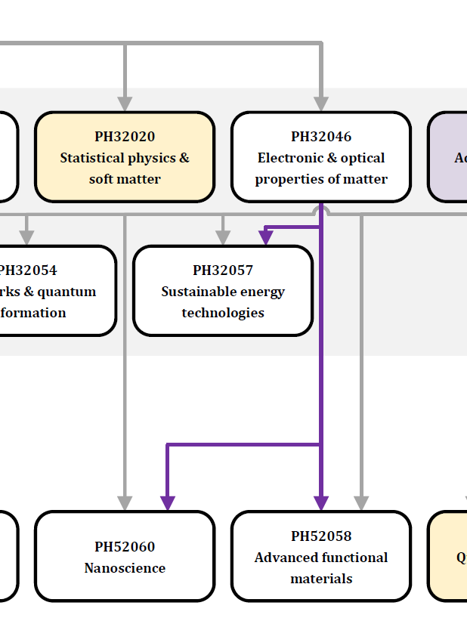
Chapter 1
Plan for part one
Review of band theory and its relationship to the electronic and optical properties of materials.
Introduction to tight binding theory.
The electronic density of states as well as other key band structure parameters and examples of them in real materials.
Phenomenology and theory of optical absorption and emission processes in semiconductors and insulators.
Models of electronic absorption in semiconductors as well as reflectivity and plasmons in metals.

Slide 5
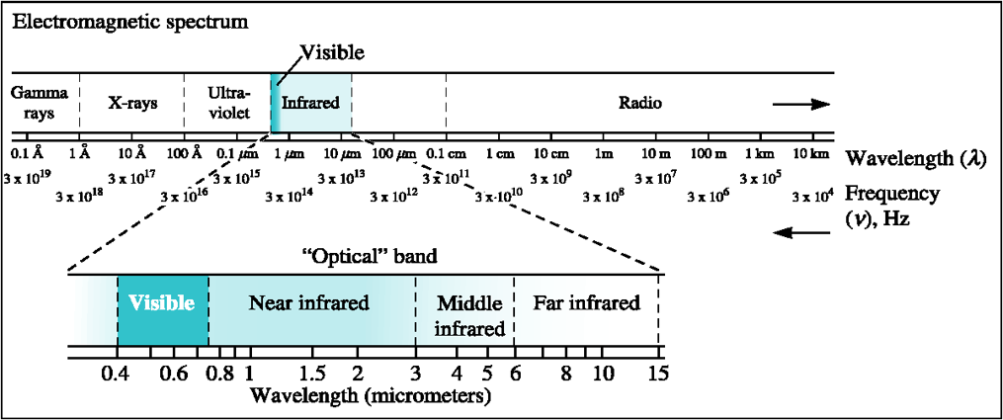
Chapter 2

Slide 6
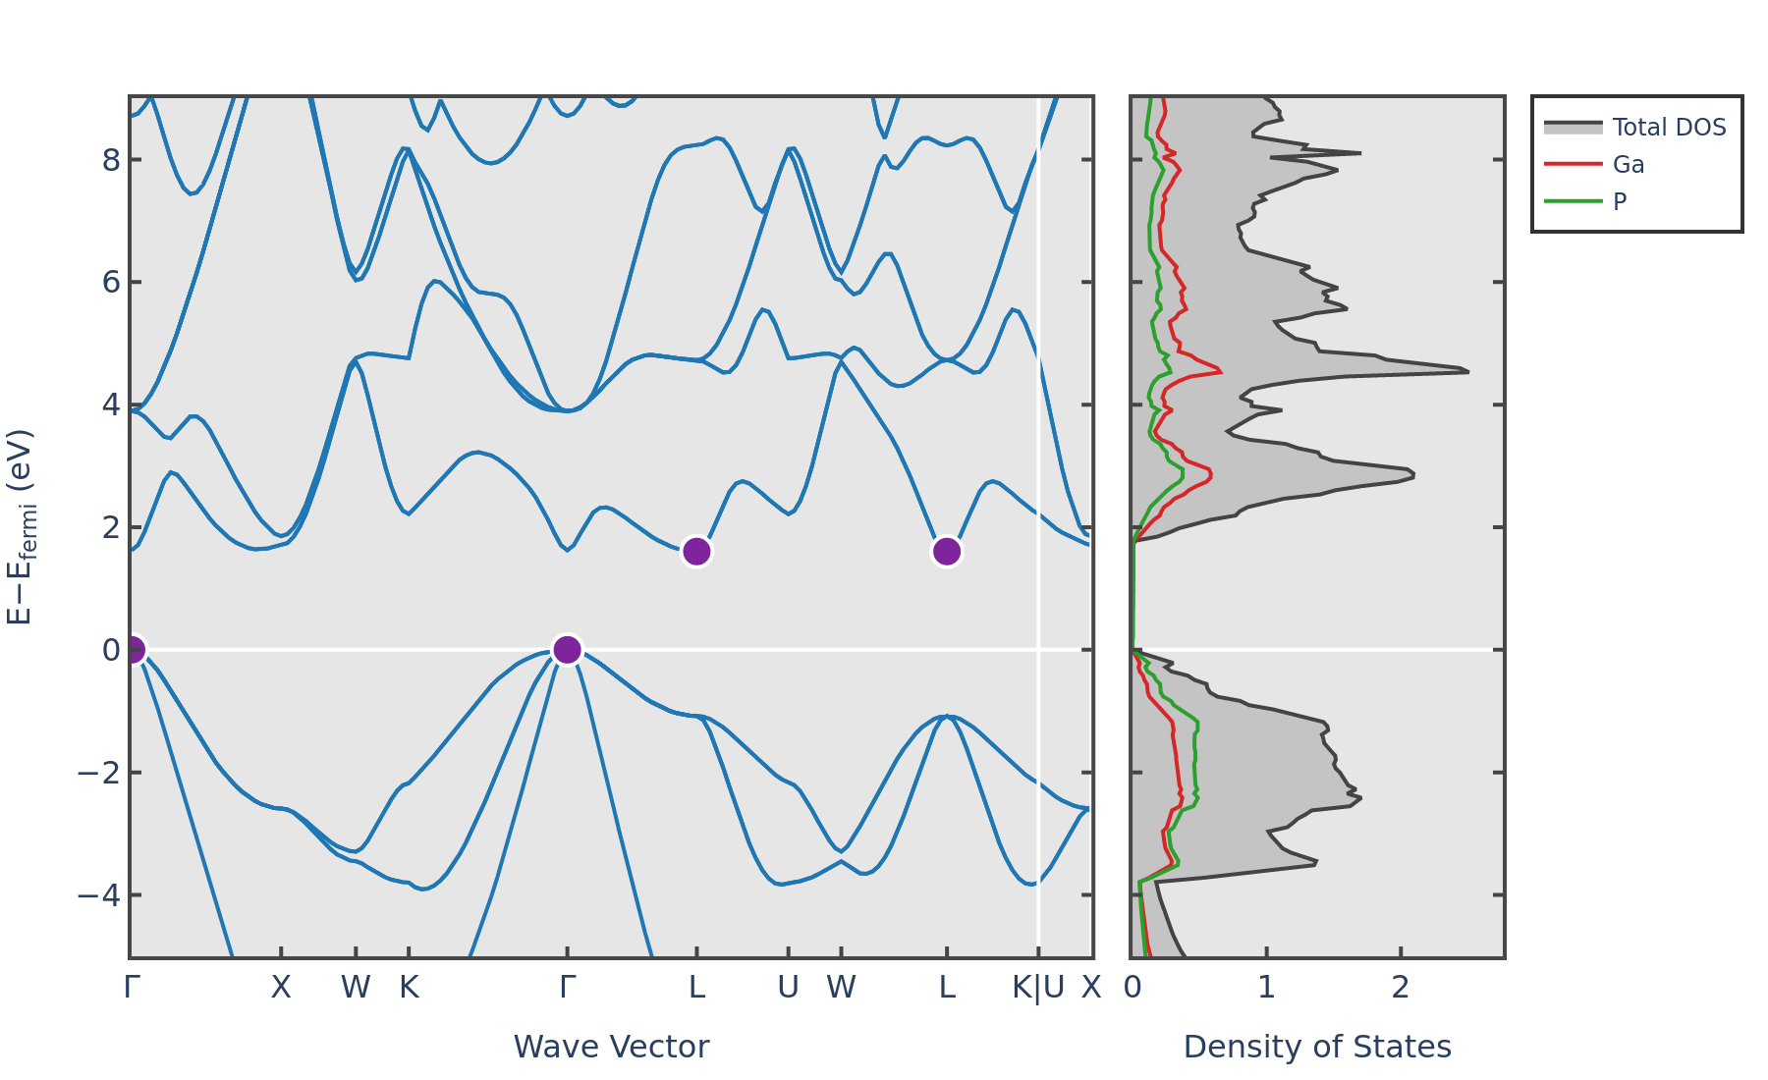
Chapter 2
Reciprocal space: 1st Brillouin zone of GaP (zincblende) structure

Slide 7
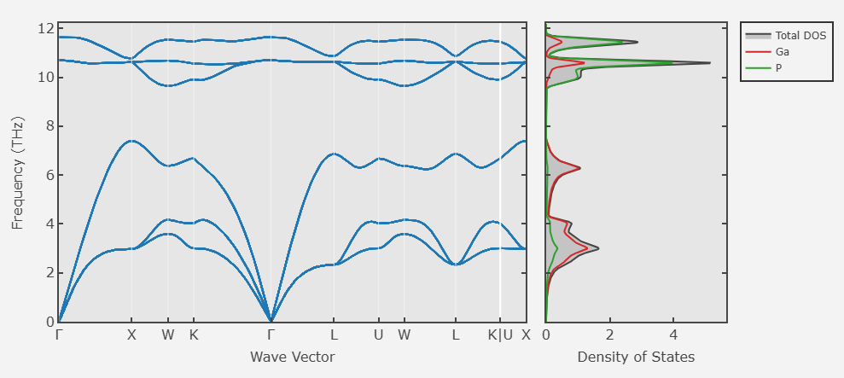
Chapter 2
Reciprocal space: 1st Brillouin zone of GaP (zincblende) structure

Slide 8
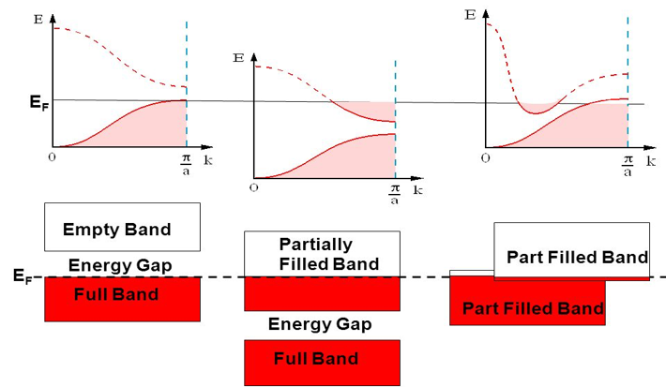
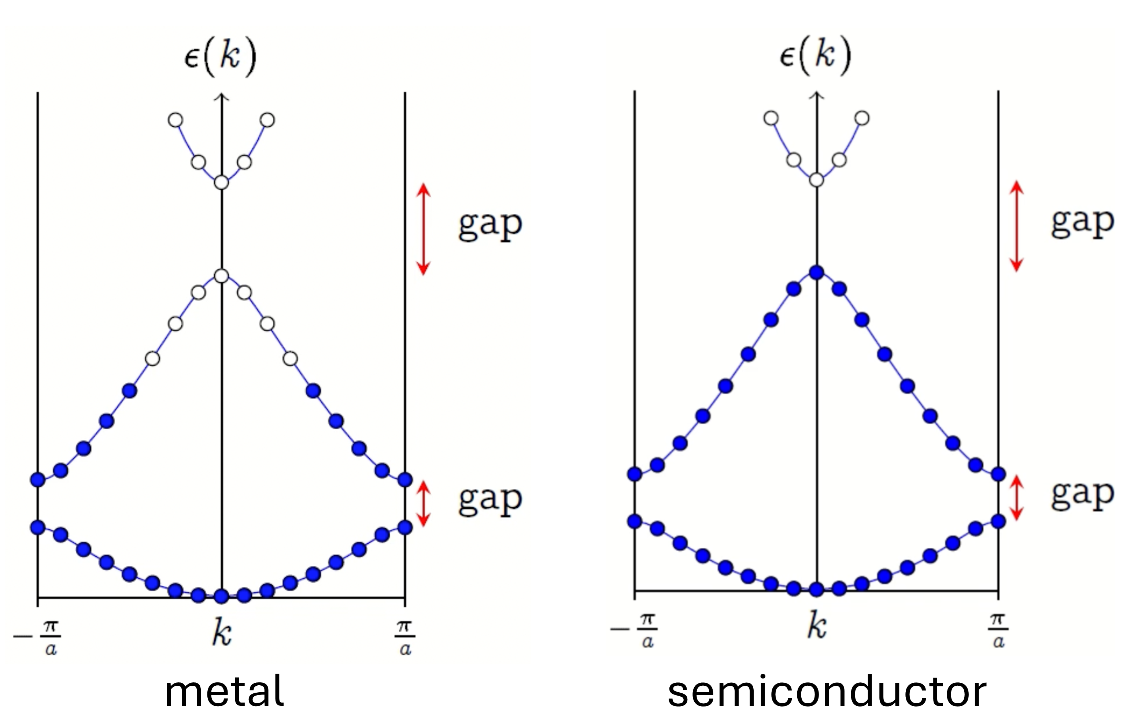
Chapter 2

Slide 9
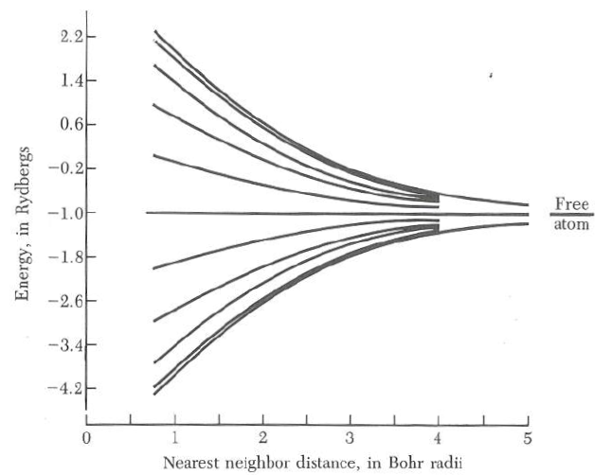
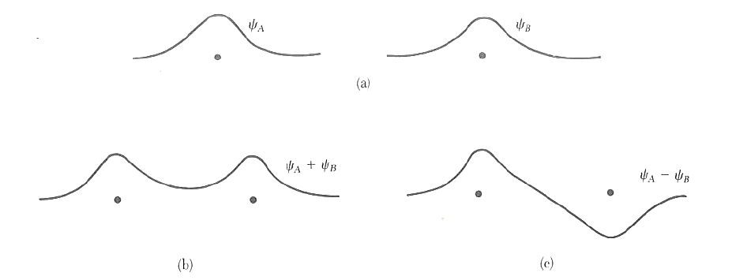
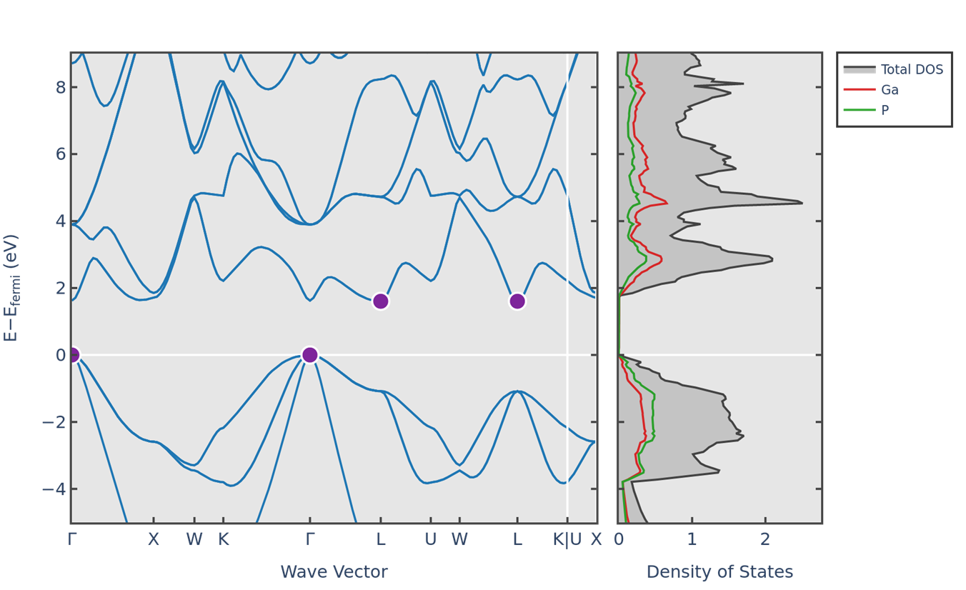
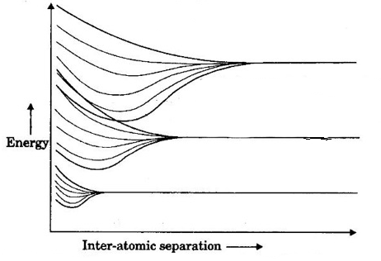
Chapter 3

Slide 10
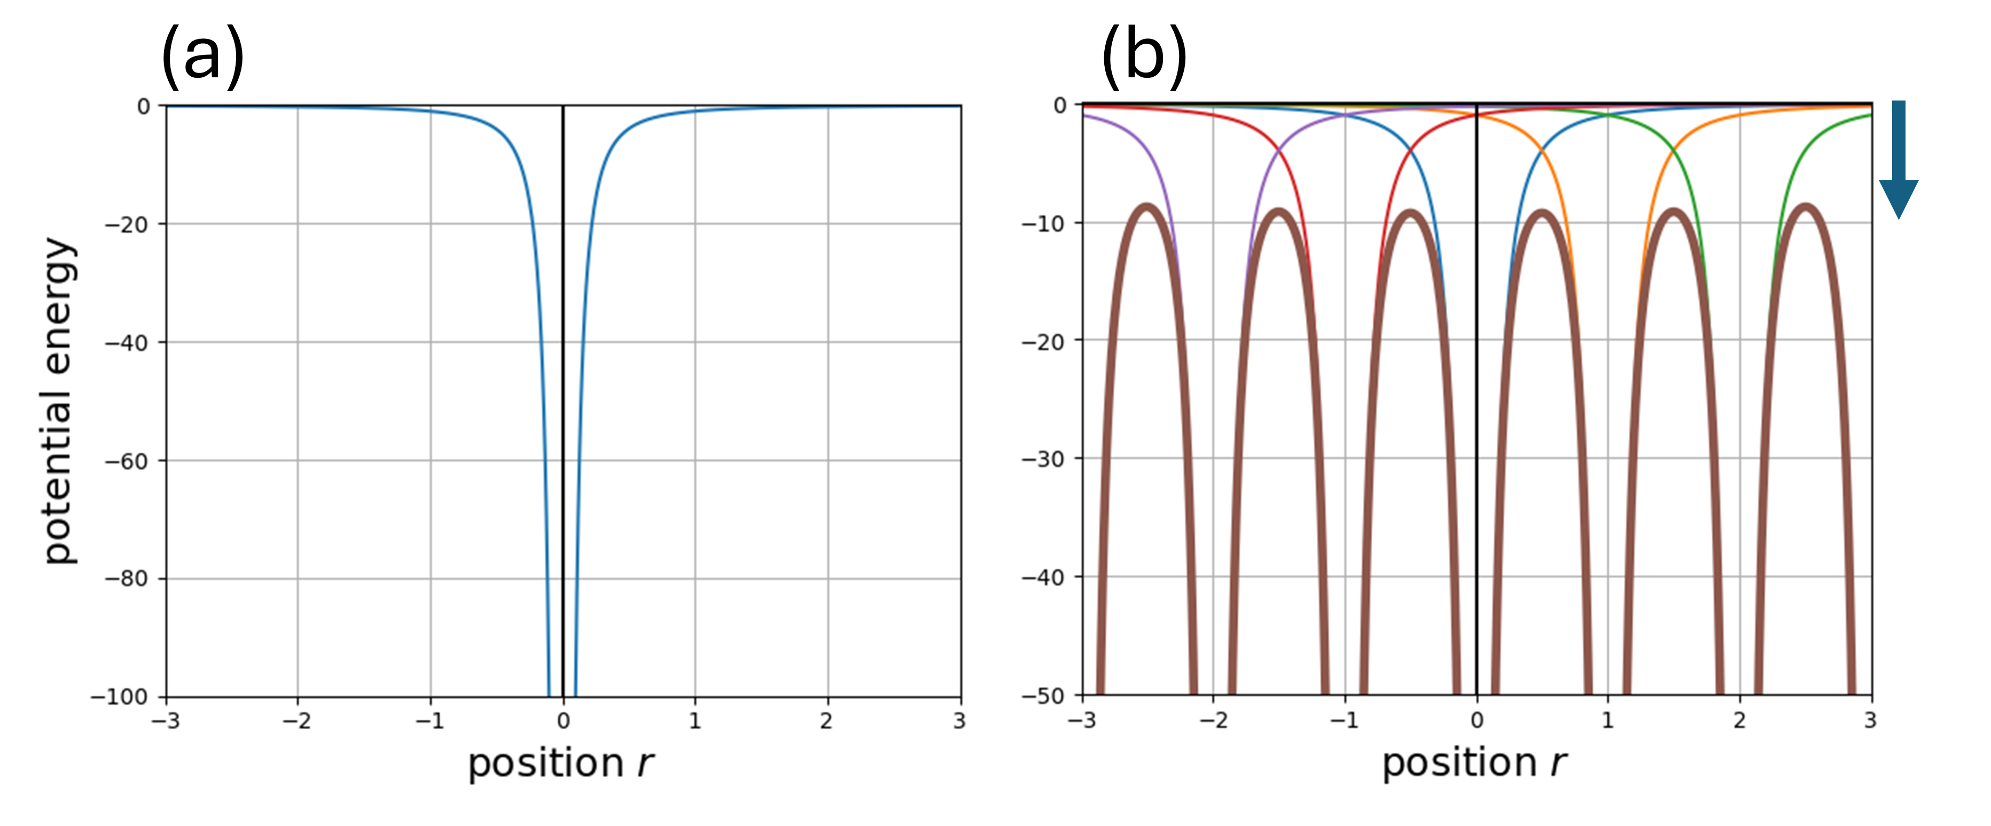
Chapter 3

Slide 11
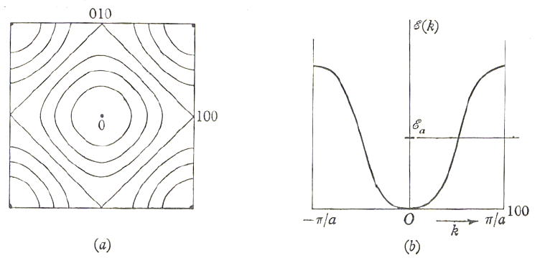
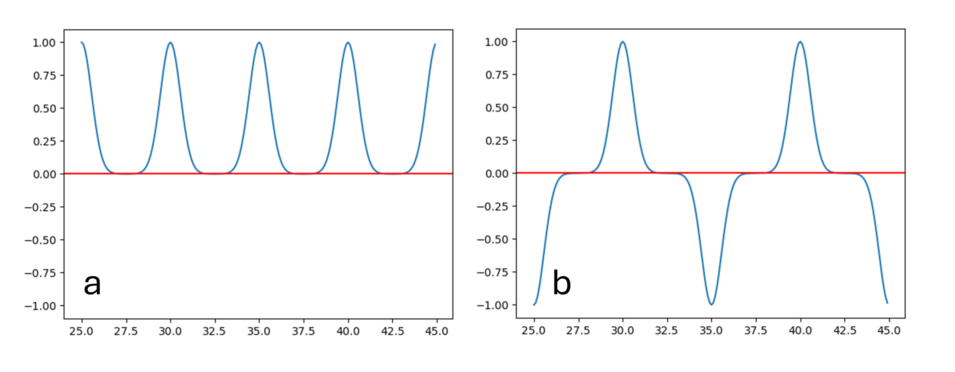
Chapter 3

Slide 12
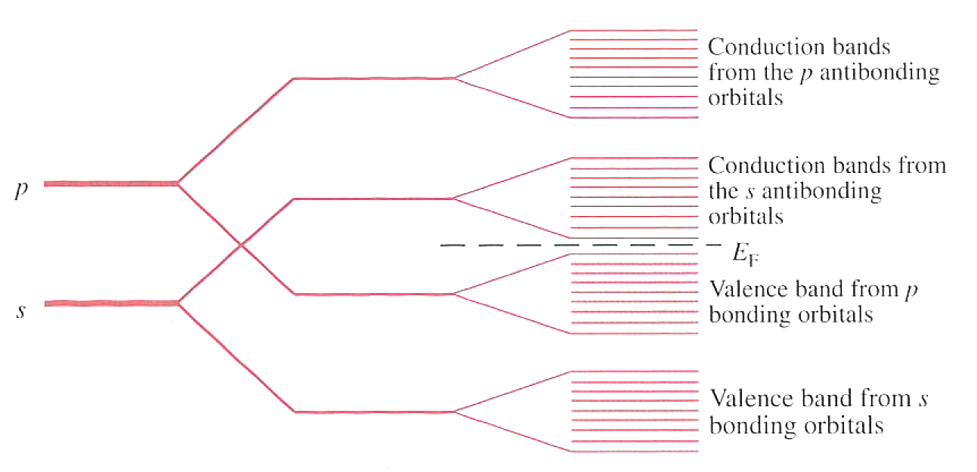
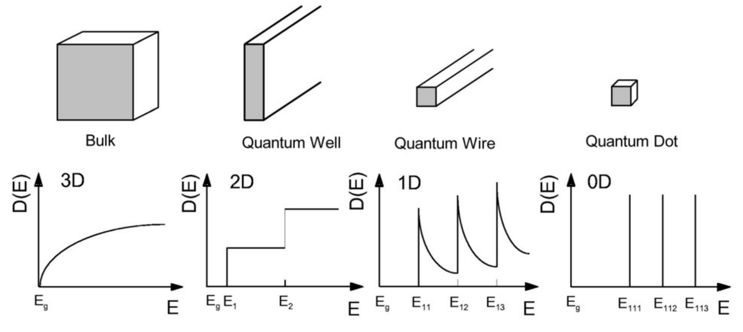
Chapter 3
Ga: 1s² 2s² 2p⁶ 3s² 3p⁶ 4s² 3d¹⁰ 4p¹
P: 1s²2s²2p⁶3s² 3p³

Slide 13
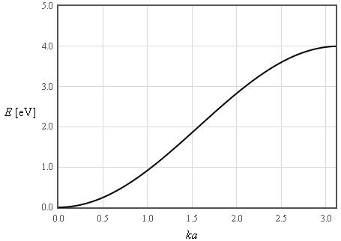
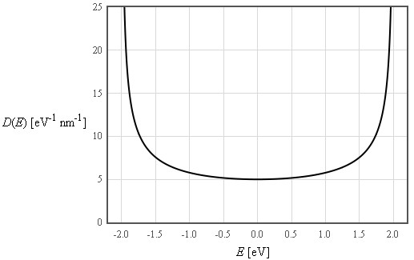
Chapter 3
Tight-binding s-band 1D chain
Dispersion
Density of states in energy

Slide 14
Chapter 3
Dispersion
Density of states in energy

Slide 15
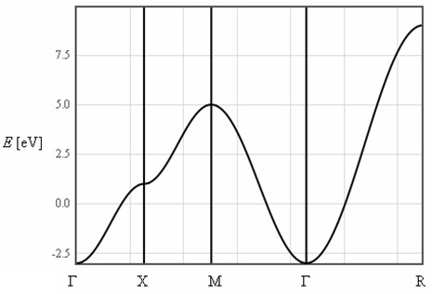
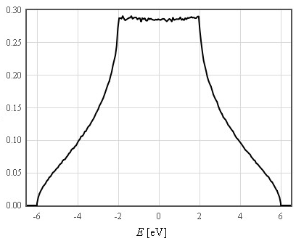
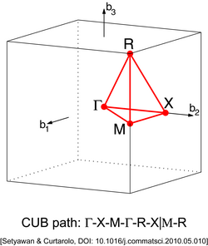
Chapter 3
Tight-binding s-band 3D simple cubic crystal
Dispersion
Density of states in energy

